Slide 1
Volatility Is Rough

Slide 2
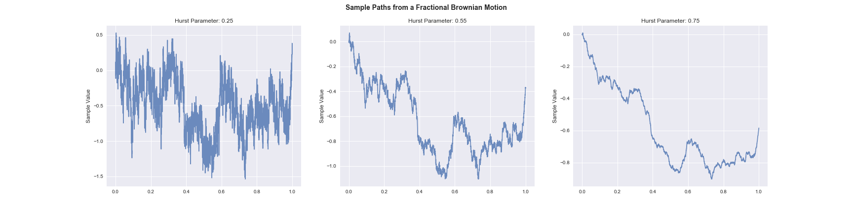
Brownian Motion Can be rough
Rough
Normal
Smooth

Slide 3
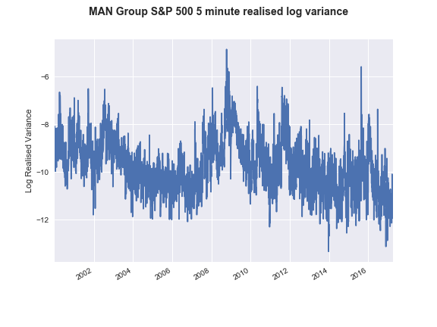
Volatility is rough
Rough!

Slide 4
What is the problem here?
The traders problem
I have a strategy and I want to weight by forecast volatility
The risk managers problem
I have a portfolio and I want to know the risk
What’s my VaR?
The derivatives dealers problem
I have a derivative that cares about forecast volatility and the path
I need to know the volatility!

Slide 5
Stylized Volatility Facts

Slide 6
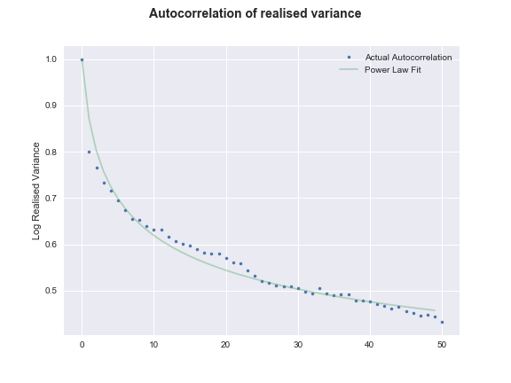
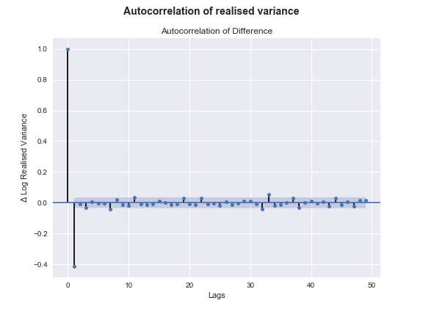
Autocorrelation of Variance
“Long memory”

Slide 7
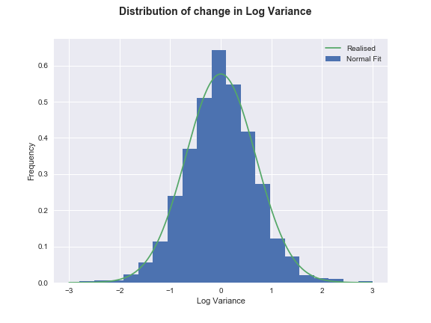
The Change in Log Variance is “Normally” Distributed

Slide 8
The Model

Slide 9
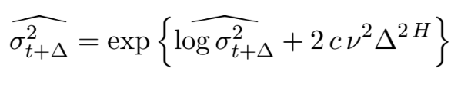
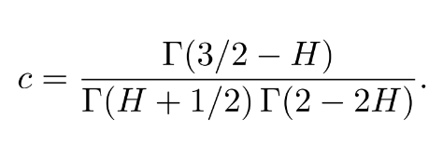
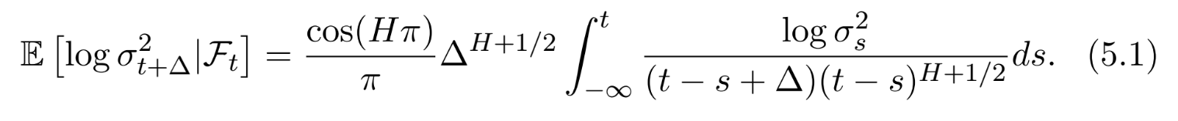
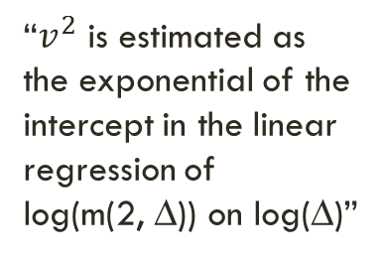
The math
Target variance!
(∆ periods ahead)
“$v^{2}$ is estimated as the exponential of the intercept in the linear regression of
log(m(2, ∆)) on log(∆)”

Slide 10
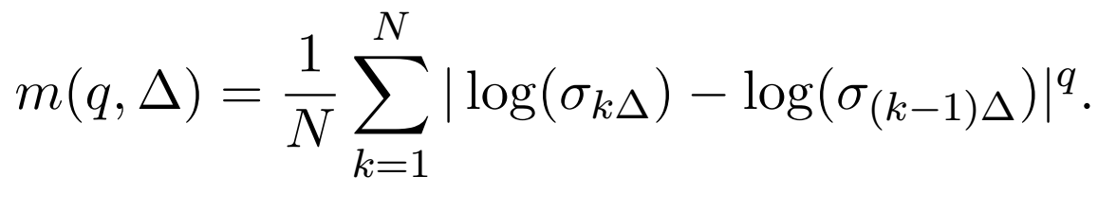
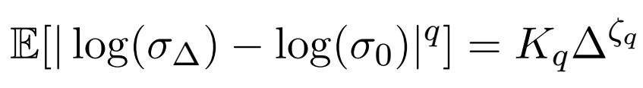

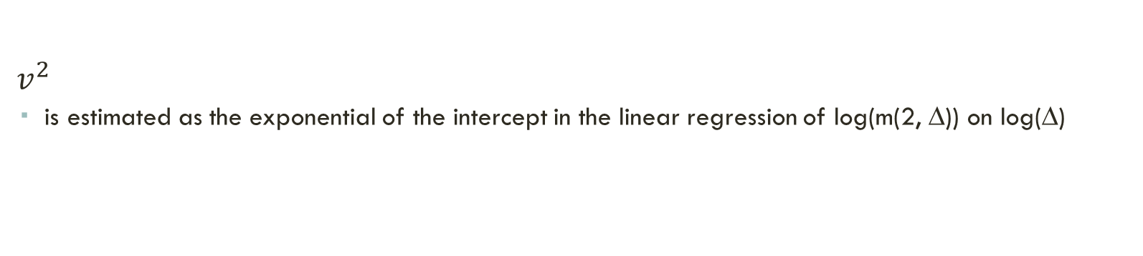
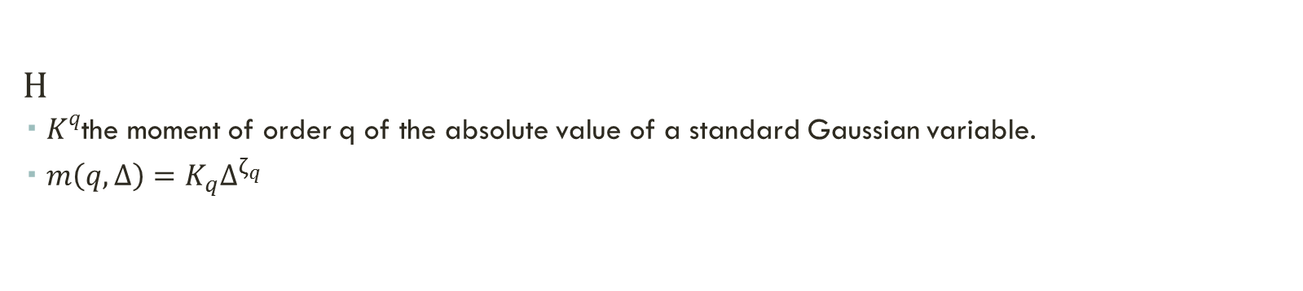
Things We Need To Estimate
$v^{2}$
is estimated as the exponential of the intercept in the linear regression of log(m(2, ∆)) on log(∆)
H
$K^{q}$the moment of order q of the absolute value of a standard Gaussian variable.
$m\left(q, ∆\right)=K_{q}∆^{ζ_{q}}$

Slide 11
How it Works
Magic?

Slide 12
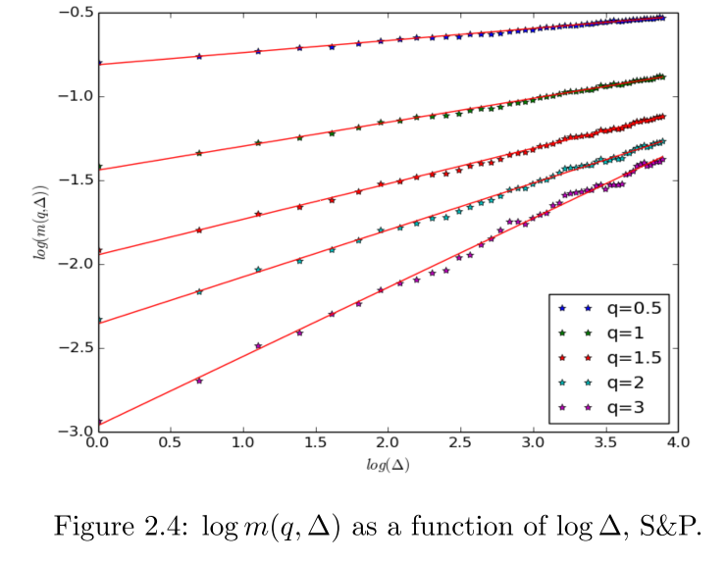

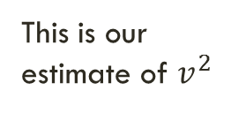
Results - $v2$
This is our estimate of $v^{2}$

Slide 13
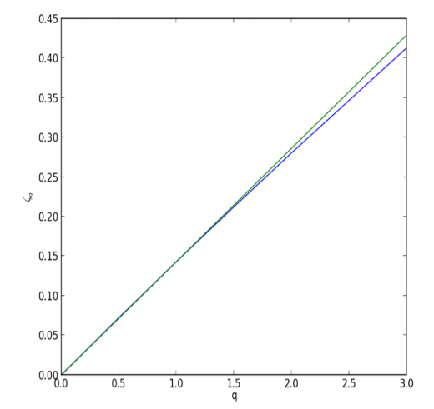

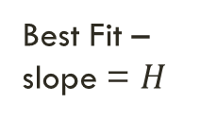

Results - $H$
Best Fit – slope = $H$
Estimate
$$ζ_{q}$$

Slide 14
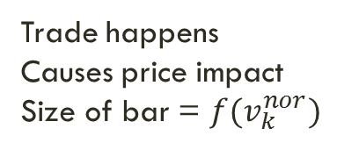
How it works
Impact decays away with time
Trade happens
Causes price impact
Size of bar = $f(v_{k}^{nor})$

Slide 15
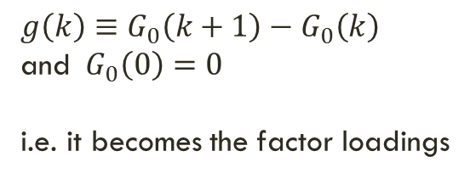
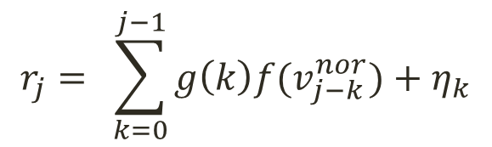
Calibration of the propagator
Run this regression
$$r_{j}= \sum_{k=0}^{j−1}{g\left(k\right)f(v_{j−k}^{nor})}+η_{k}$$
(24)
$g\left(k\right)≡G_{0}\left(k+1\right)−G_{0}\left(k\right)$
and ${ G}_{0}\left(0\right)=0$
i.e. it becomes the factor loadings
We observe this from before

Slide 16

The math
Constants
Makes it bigger as H gets smaller
Makes it bigger as ∆ gets bigger
Log variance, ∆ periods ahead
Sort of like an EWMA, decays past history
Approximated with Reimann
The filtration of $W^{H}$, in our case its the past history

Slide 17
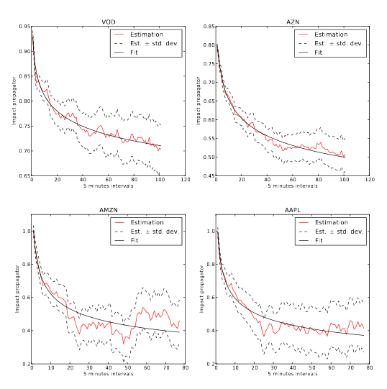
Results

Slide 18
Multiple period executions
Second execution “stacks” on top of previous trade
First execution decays a bit

Slide 19
Multi-period executions
Executions cause market impact at a declining rate
Impact decays when trading stops

Slide 20
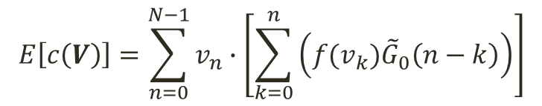
Computing the total trade cost
We know what we’re trading per unit of time
We compute how the price will (should) change per unit of time
Total cost is just the sum product
$$E\left[c\left(V\right)\right]=\sum_{n=0}^{N−1}{v_{n}∙\left[\sum_{k=0}^{n}{\left(f(v_{k}){\tilde{G}}_{0}\left(n−k\right)\right)}\right]}$$
Volume per unit of time
(the execution path)
How much the price has moved at each moment in time

Slide 21
Optimal Executions

Slide 22
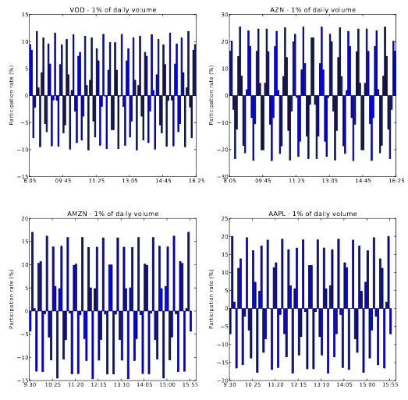
How do we trade? – Zero spreads
Cause market impact
Trade against it
Cause market impact
Trade against it

Slide 23
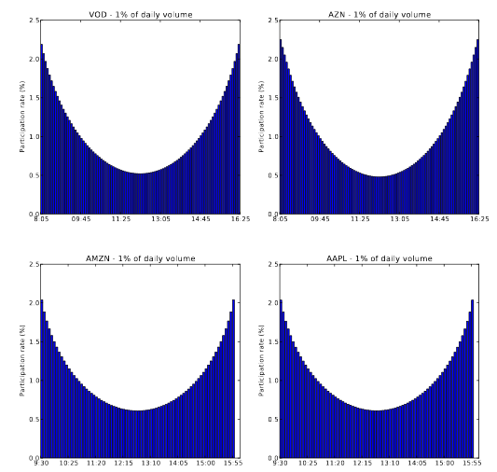
How do we trade? – With Spreads
Trade fast – very toxic flow on unsuspecting market
Slow down – let the price come back to you a bit
Trade fast again – price has come back so take advantage

Slide 24
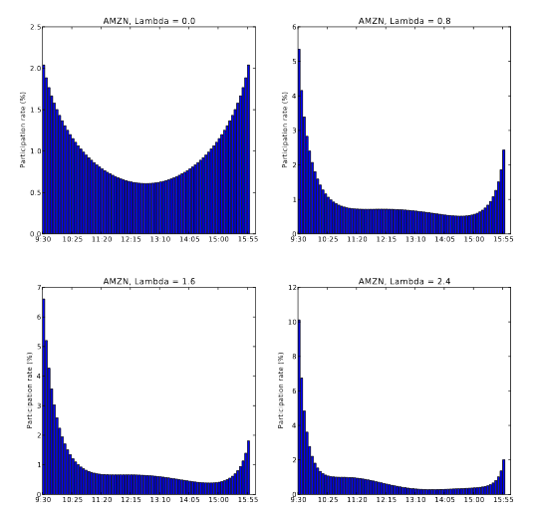
How do we trade? – With Spreads and Risk Aversion
Risk aversion parameter
As before,
trade fast
then slow
then fast
Front load because we are risk averse
Look familiar?

Slide 25
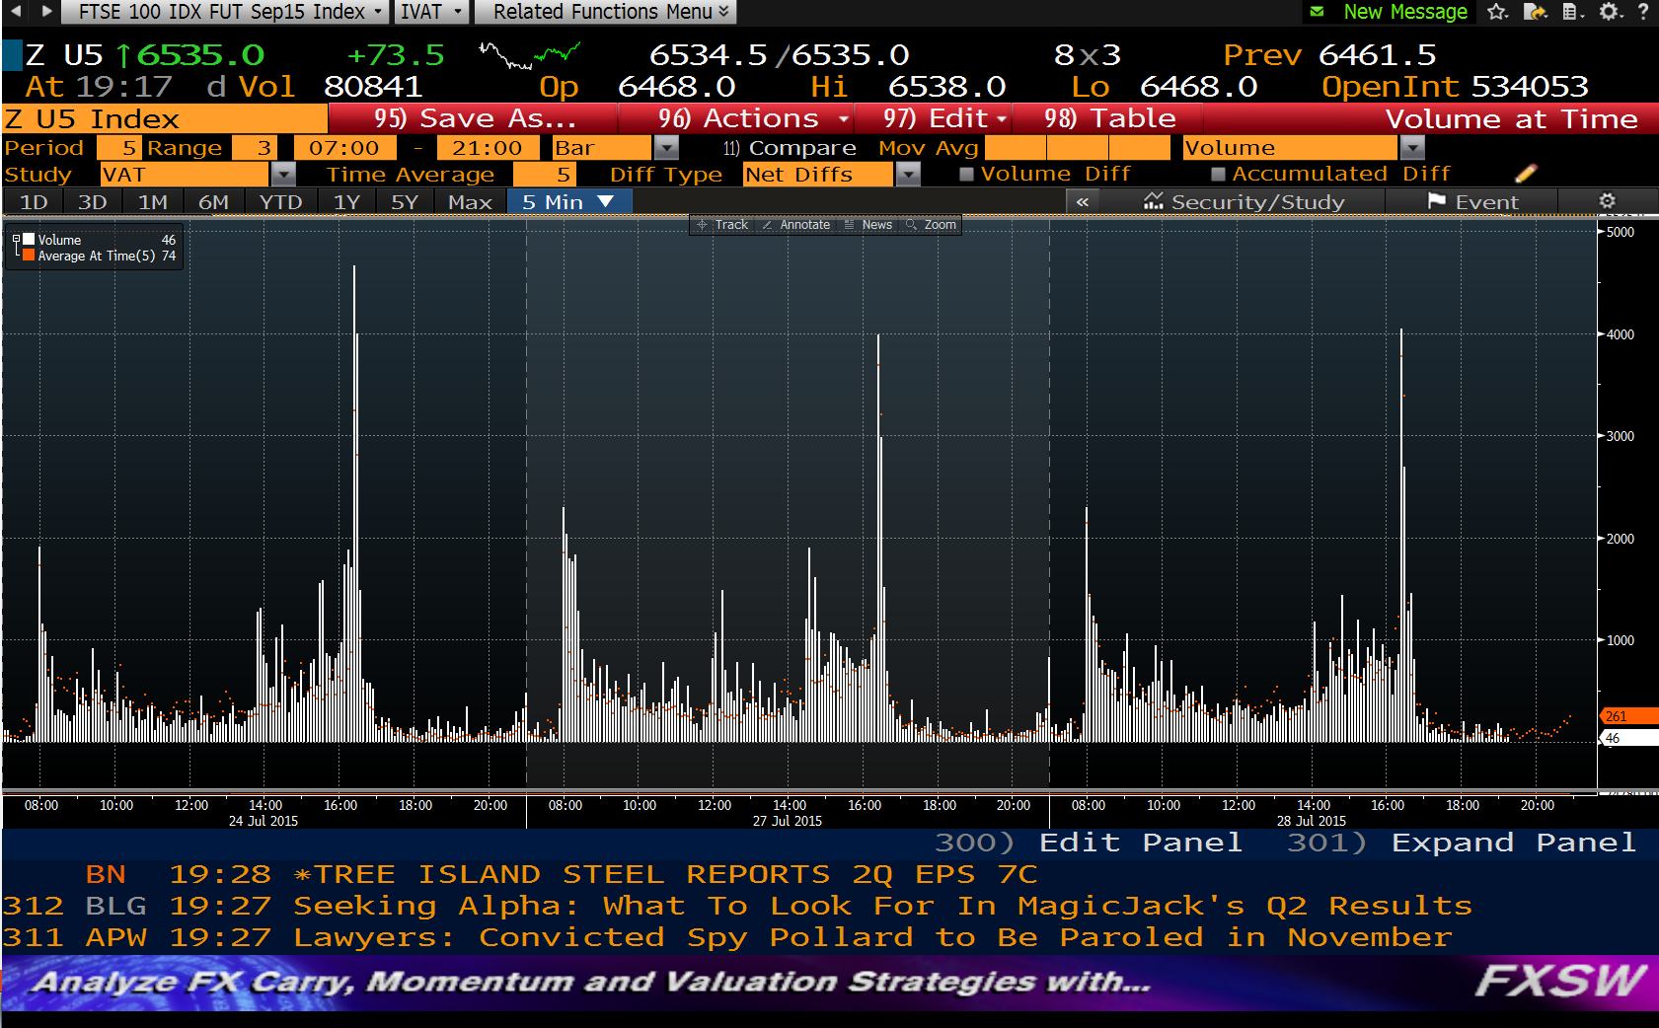
Look familiar?

Slide 26
Closing Remarks

Slide 27
Tying it all together
The asset managers problem
I have a big order and want to execute it as cheaply as possible
The risk managers problem
I want to know how much it will cost me to unwind my portfolio in some time frame
“People are worried about bond market liquidity”
The hedge funds problem
I have a small trading strategy and want to exploit it as much as possible

Slide 28
Questions?
Market makers – do you look for large orders?
Buy side – do you use pre-trade market impact models?
Autocorrelation of trades?

Slide 29
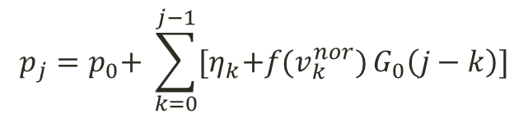
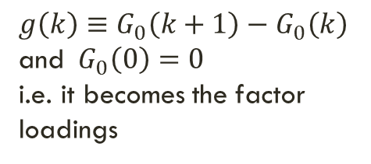
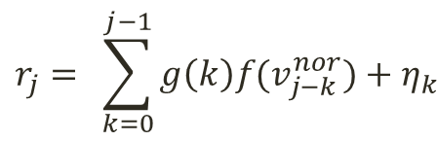
Recaps
Run this regression
$$r_{j}= \sum_{k=0}^{j−1}{g\left(k\right)f(v_{j−k}^{nor})}+η_{k}$$
$g\left(k\right)≡G_{0}\left(k+1\right)−G_{0}\left(k\right)$
and ${ G}_{0}\left(0\right)=0$
i.e. it becomes the factor
loadings
We observe this from before
Instantaneous impact function
$$p_{j}=p_{0}\text{+ }\sum_{k=0}^{j−1}{{[η}_{k}+f(v_{k}^{nor})}G_{0}\left(j−k\right)\text{]}$$
Initial price
$$E\left[c\left(V\right)\right]=\sum_{n=0}^{N−1}{v_{n}∙\left[\sum_{k=0}^{n}{\left(f(v_{k}){\tilde{G}}_{0}\left(n−k\right)\right)}\right]}$$
Unexplained error
Impact propagator
Volume per unit of time
How much the price has moved at each moment in time

